Slide 1

WEYLAND ENERGY
Pipeline Review Q3 2026
Executive Board · 6 October 2026

Slide 2
Pipeline at a glance
4.2 GW
35
1.1 GW
4
total pipeline
active opportunities
probability-weighted
countries
• Offshore (2.1 GW) is half of the pipeline – onshore, solar and storage carry the 2028–2030 build-out
WEYLAND ENERGY · Pipeline Review Q3 2026
2

Slide 3
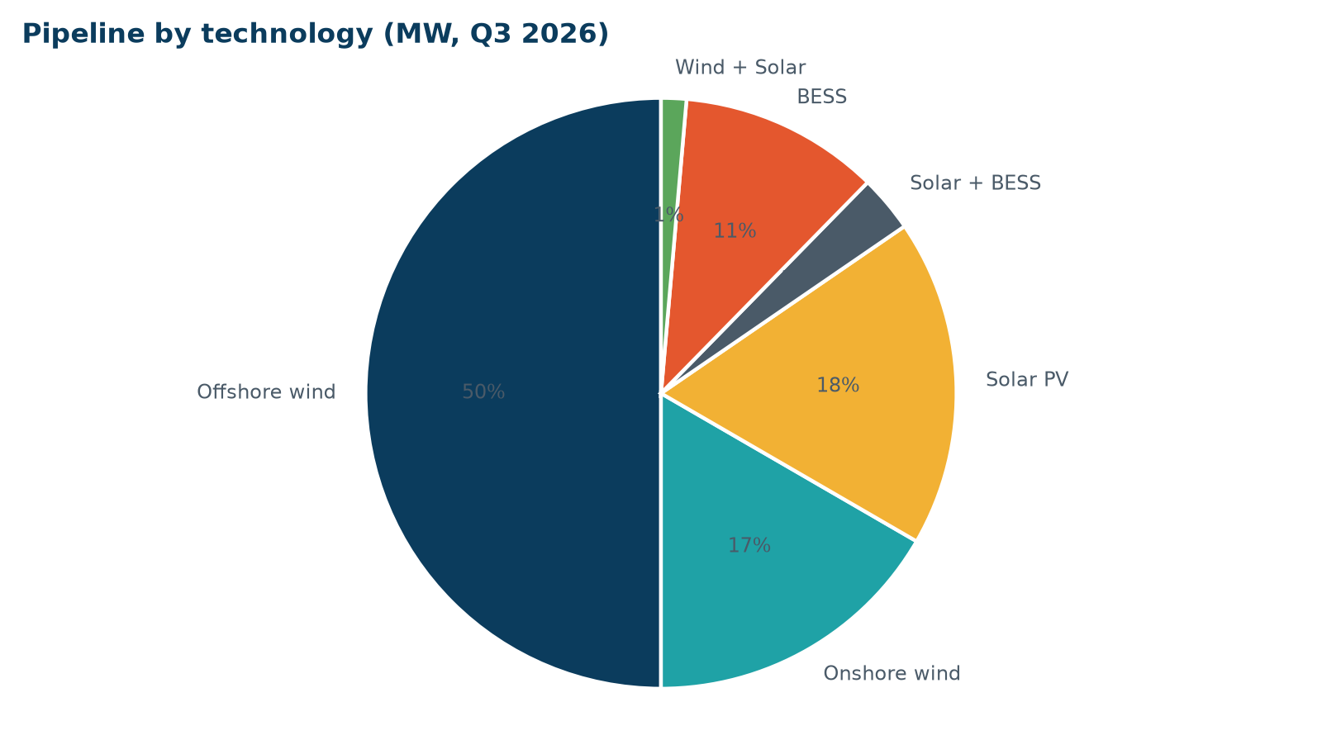
By technology
• Offshore wind: 2,100 MW
• Onshore wind: 699 MW
• Solar PV: 753 MW
• Solar + BESS: 130 MW
• BESS: 460 MW
• Wind + Solar: 58 MW
WEYLAND ENERGY · Pipeline Review Q3 2026
3

Slide 4
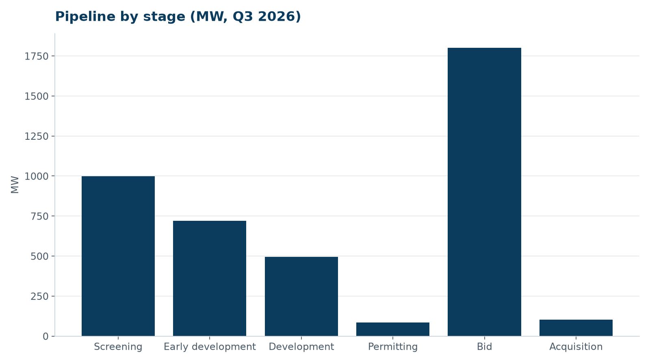
By stage
• Screening funnel is healthy
• Too few projects in permitting for our 2029–2030 build-out target
WEYLAND ENERGY · Pipeline Review Q3 2026
4
Notes:
Amara: emphasise that we need two more onshore projects in permitting by mid-2027.

Slide 5
Largest opportunities
ID | Opportunity | MW | Stage | Next gate
PL-001 | Northfield Offshore Wind | 1,200 | Bid | Bid submission (2026-11-27)
PL-003 | Fehmarn Nord Offshore Wind | 600 | Bid | Tender qualification (2027-02-15)
PL-002 | Harrow Bay Extension | 300 | Screening | Seabed agreement application (2027-03-31)
PL-035 | Fyn Coast Solar | 203.0 | Early development | Landowner agreements (2027-01-29)
PL-020 | Värmland Wind | 150 | Early development | Municipal veto clarification (2027-03-31)
PL-018 | Halland Wind | 120 | Development | Environmental permit (2027-09-30)
PL-017 | Altmark Solar | 110 | Screening | Site screening (2027-01-15)
PL-021 | Fenwick Battery Storage | 100 | Early development | Grid offer (2027-06-30)
WEYLAND ENERGY · Pipeline Review Q3 2026
5

Slide 6
Decisions this quarter
• Glenmore: proceed to binding offer with price adjustment (IC 29 July)
• Northfield: bid strategy approved, max. option fee set (IC 23 Sept)
• Saltmarsh Solar: go (24 June)
• Solberg portfolio: no-go (5 May)
WEYLAND ENERGY · Pipeline Review Q3 2026
6

Slide 7
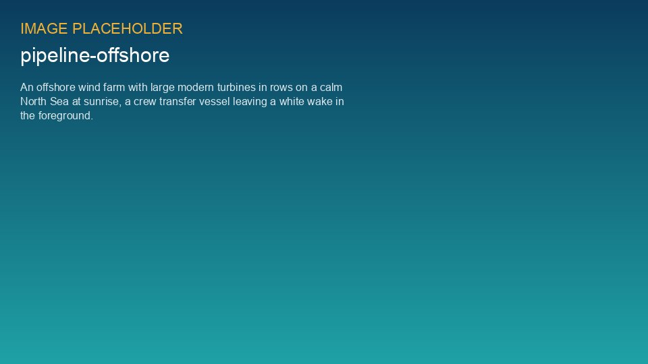
Offshore – the big swing
Northfield (1.2 GW) bid due 27 November 2026

Slide 8
Asks to the board
• Confirm risk appetite for Northfield option fee
• Approve EUR 2.4 m additional development budget for 2027
• Endorse partnership search for Fehmarn Nord
WEYLAND ENERGY · Pipeline Review Q3 2026
8

Slide 9
WEYLAND ENERGY
Thank you
Dr. Amara Okafor · Henrik Larsen

